Slide 1
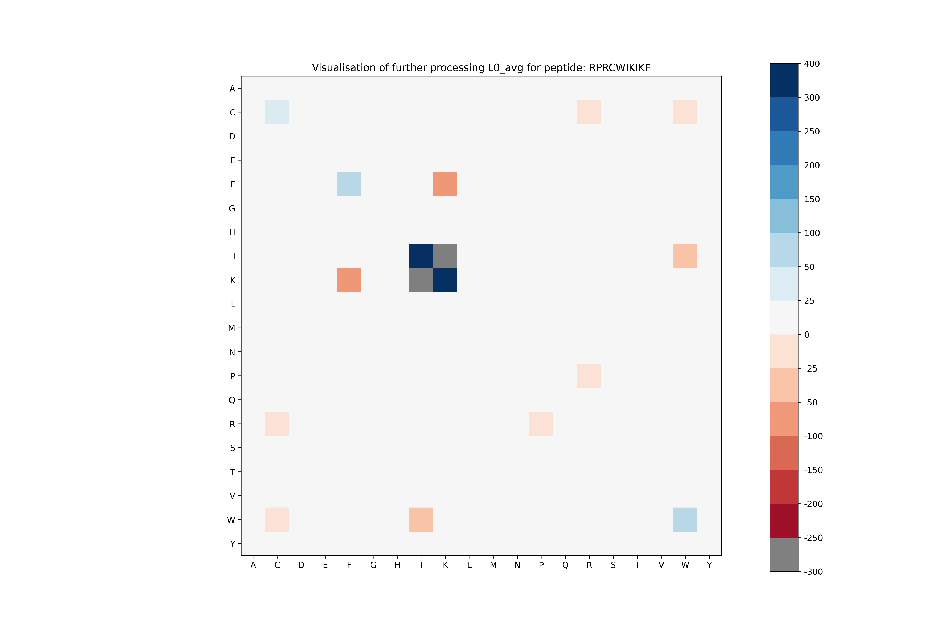
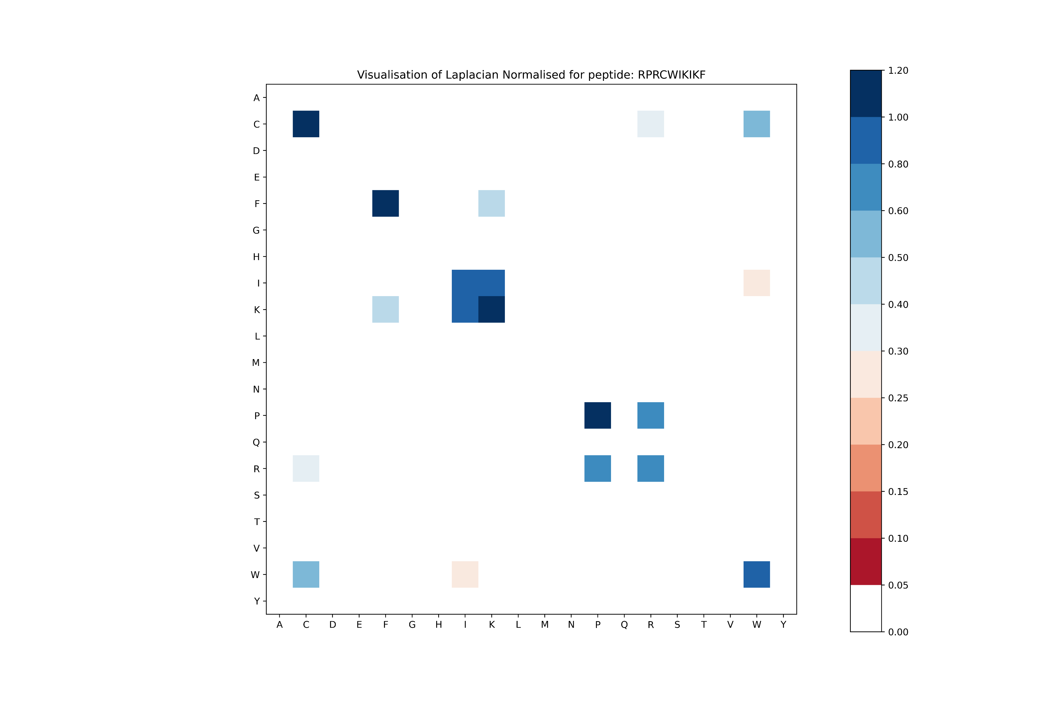
Updated diagrams for RPRCWIKIKFRCKSLKF (L0_avg)
Unormalized
Normalized
test

Slide 2
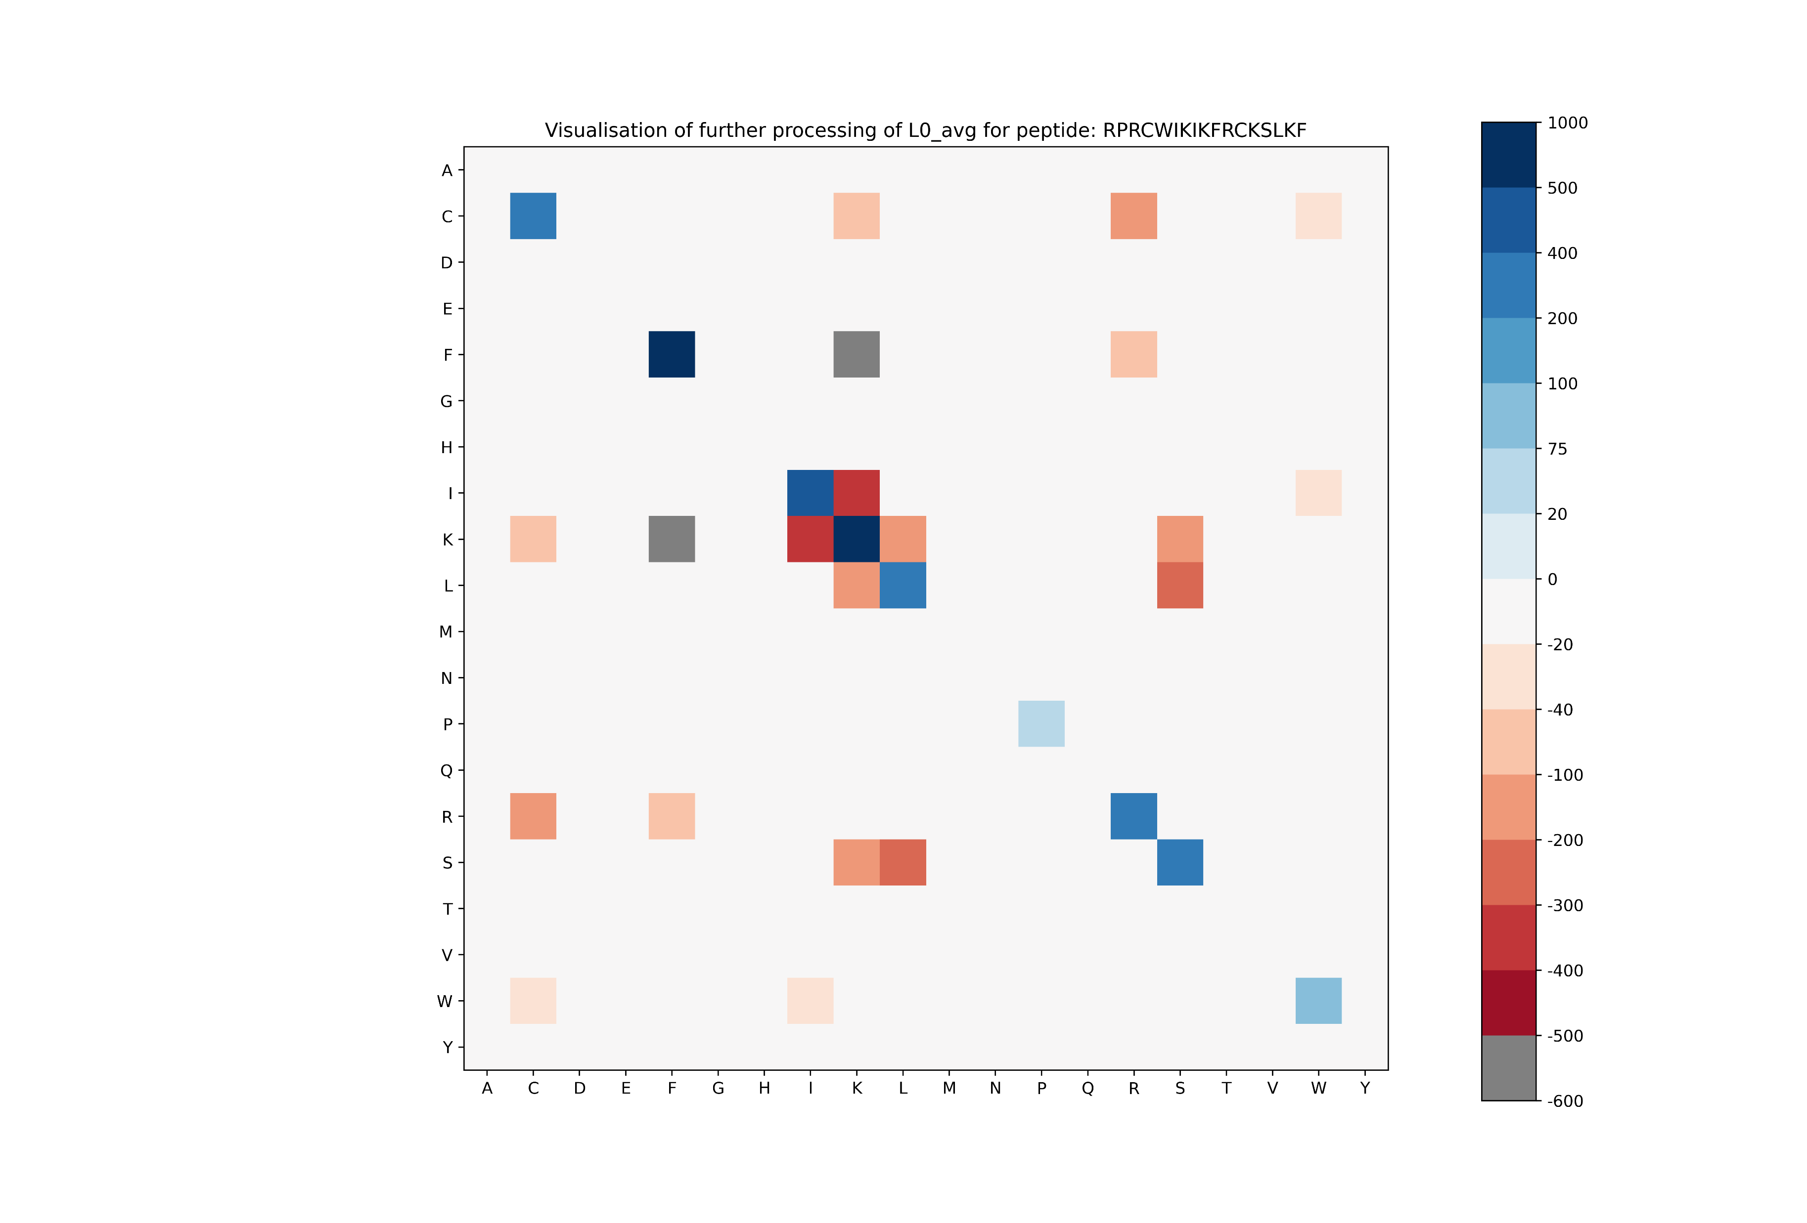
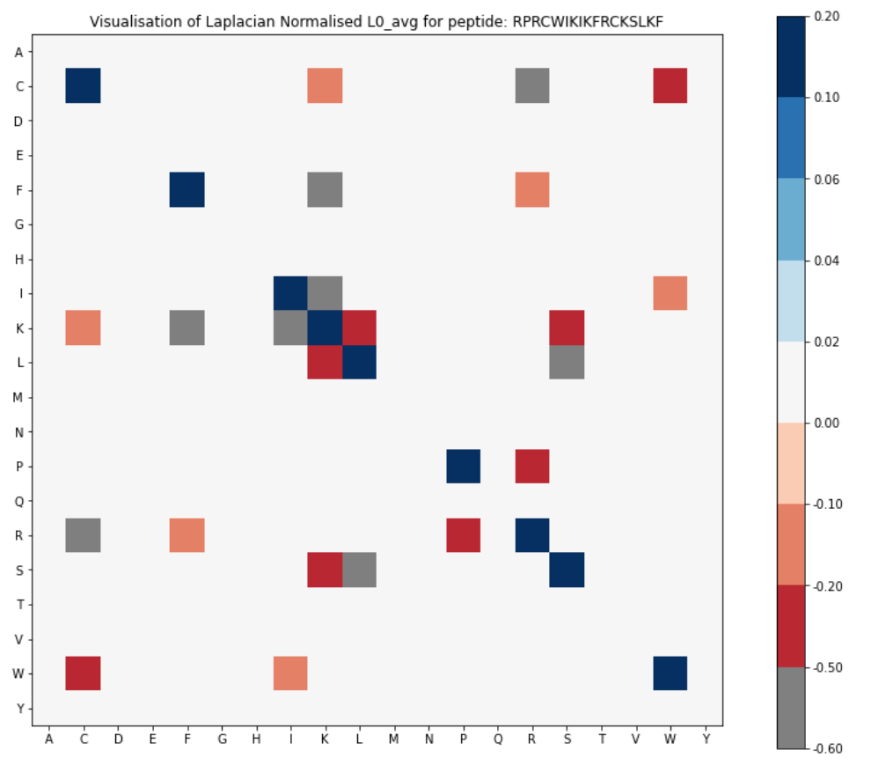
Updated diagrams for RPRCWIKIKFRCKSLKF (L0_avg)
$$L_{0}$$
$${\tilde{L}}_{0}$$
(a)
(b)

